Slide 1
Are Electric Vehicles a Viable Replacement for Gas Powered Vehicles
Ryan Frank
Bellevue University
DSC500-304: Introduction to Data Science
Professor Fadi Alsaleem
10/29/2023

Slide 2
Questions
What are the costs to construct EVs?
What are the ownership costs for EVs vs traditional cars
Can the production scale?
What are the environmental costs?

Slide 3
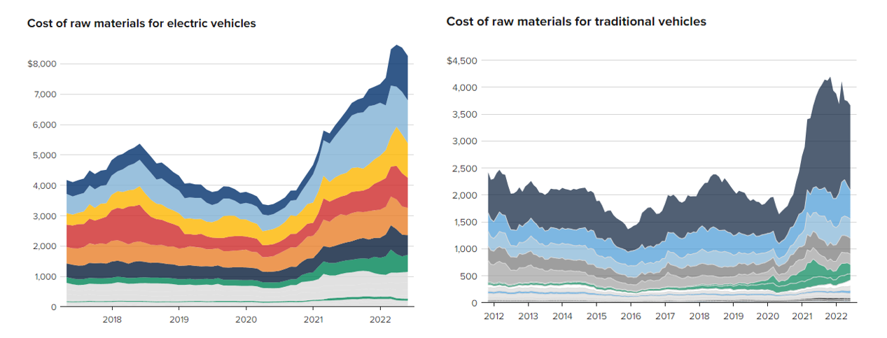
Construction Cost
EV’s raw material cost is approximately double that of traditional vehicles

Slide 4

Consumer Cost
Similar classes of vehicles cost about $10,000 more for an EV
Cost of Operation
EV ICE
Cost doesn’t equalize until 125,000 mile driven on average
5.4 ¢ / mile
13.4 ¢ / mile

Slide 5
Scalability
Lithium is one of the biggest limiting materials with scaling up the production of EVs as all batteries require it (on average each EV needs 8 kg)
Last year 130,000 Metric Tons of lithium was mined
To replace 25% of all cars with EV’s worldwide would require approximately 1,300,000 Metrics Tons of lithium
Other materials (nickel, cobalt, manganese, and graphite) have similar concerns

Slide 6
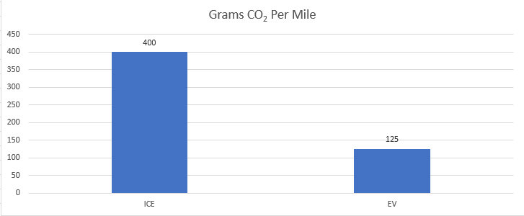
Pollution Production
EVs produce significantly less CO₂ on average per mile traveled
  Based on average pollution produced by power needed to charge EV to travel a mile vs that directly produced by a car with an internal combustion engine
More difficult to quantify, but EV’s require large amounts of rare earth metals that traditional vechiles do not – extraction of these materials often causes heavy local pollution, especially water pollution

Slide 7
Conclusions
Use of EV’s would represent significant reductions in greenhouse gas production by vehicles
Technology needs more time to mature before large scale replacement is feasible
Reductions in cost, material use, and battery technology will make it more attractive

